Slide 1
1. Install Java 1.8 on your computer! 2. Check by typing “java -version” into Windows command prompt / Mac terminal. 3. Version > 1.8 appears? Great ☺ Just sit tight 4. “'java' is not recognized” or Version 1.8 < ? ☹ 5. Go to “https://java.com/en/download/manual.jsp” (Or just google “How to install java 1.8 on Windows/Mac”)
INSTRUCTIONS Part 1
Recommended: Install a good text editor (notepad is trash) 1. Notepad++ / Sublime Text 3 (Windows) 2. Sublime Text 3 / ATOM (Mac) 3. Vim (Universal, for advanced users)

Slide 2

Artificial Intelligence to play sudoku

Slide 3

Less technical
More intuition
Notes:
This workshop is more about intuition and seeing how the AI stuff performs. So expect a lot of handwaving over technical details. After all, this is several 3~4K CS modules condensed into 25 minutes.

Slide 4
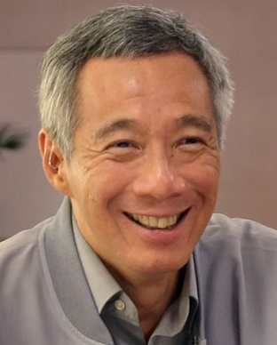
What is so special?
“I used to enjoy this; it is a long time since I’ve done anything. The last programme I wrote was a Sudoku solver in C++ several years ago, so I’m out of date.”, (2015 LHL)
PM Lee Hsien Loong

Slide 5
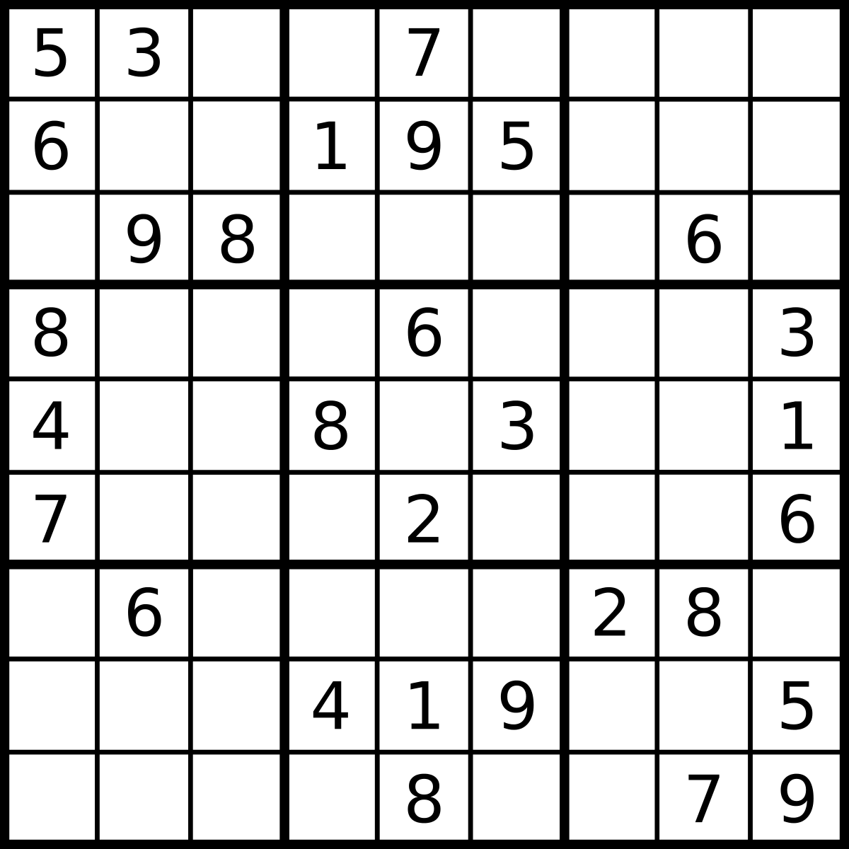



Turns out Sudoku is
NP-Complete
$$n$$
$$n$$
TLDR:
solving $n^{2}∗n^{2}$ Sudoku is HARD
Problem grows exponentially
Solving it fast can net you 1 million USD
(Millennium Prize Problems)

Slide 6
7 Billion
1 Million

Slide 7
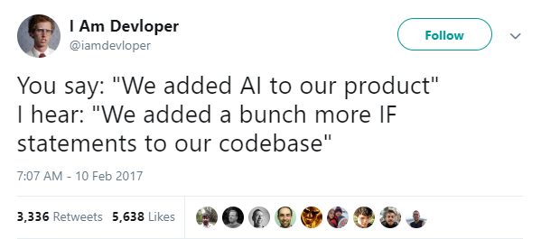
What is A.I?
Notes:
Term people like to throw around to sound smart. Such as “building a smart nation etc”.

Slide 8
What is A.I?
TLDR:
Modelling the problem
Searching for potential solutions
Planning steps to solve
Getting ~ lucky ~
Notes:
Term people like to throw around to sound smart. Such as “building a smart nation etc”.

Slide 9
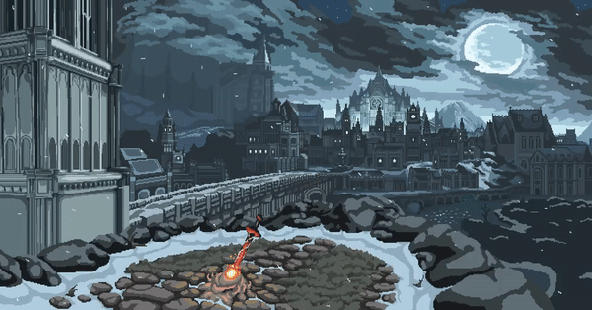
Coding hell begins https://goo.gl/KJ7wJ7

Slide 10
1. Extract and navigate to the “DIY CODE” Folder. 2. Copy path of folder (top URL) & open Console/Terminal 3. type [cd “PASTE PATH HERE”], you should be in the “DIY CODE” folder within Console/Terminal. 4. Open “GameGen.java” in your text editor 5. Start coding with us ☺ 6. Compile using “javac Main.java” 7. Run using “java Main”
INSTRUCTIONS Part 2
GitHub Link: https://goo.gl/KJ7wJ7

